Slide 1

“Sleep Grand Rounds”
“February 1, 2023”
Claim Credit Code: “24658”
Three ways to claim credit:
Via the CloudCME App
Visit our website - https://intermountain.cloud-cme.com
Text the code to CloudCME – 844.989.1332
*You must claim credit within 24 hours of the session*
The evaluation for today’s RSS is available on the CloudCME App under “My Evaluations.”

Slide 2
Why should inpatient hypercapnia matter to outpatient providers?
Brian Locke MD
3rd Year PCCM Fellow
NIH T32 Research Fellow
Masters of Science in Clinical Investigation Student
ATS ASPIRE 2022—24 Fellow
Disclosures: research support from the National Institutes of Health under Ruth L. Kirschstein National Research Service Award 5T32HL105321 and the American Thoracic Society ASPIRE program (supported by ResMed, Philips Respironics, and Fisher & Paykel).

Slide 3
Roadmap & Learning Goals
What is hypercapnic respiratory failure?
What guidelines say to do with hypercapnic respiratory failure?
Goal: Understand limitations on current guidelines to the management of all-comers with hypercapnic respiratory failure.
Who gets hypercapnic respiratory failure?
Goal: What is known and unknown about the role of obesity and OSA
Current Research
How could we do it better?
Notes:
Last year: Bicarbonate, rates of missed diagnoses (high), cohort study definitions

Slide 4
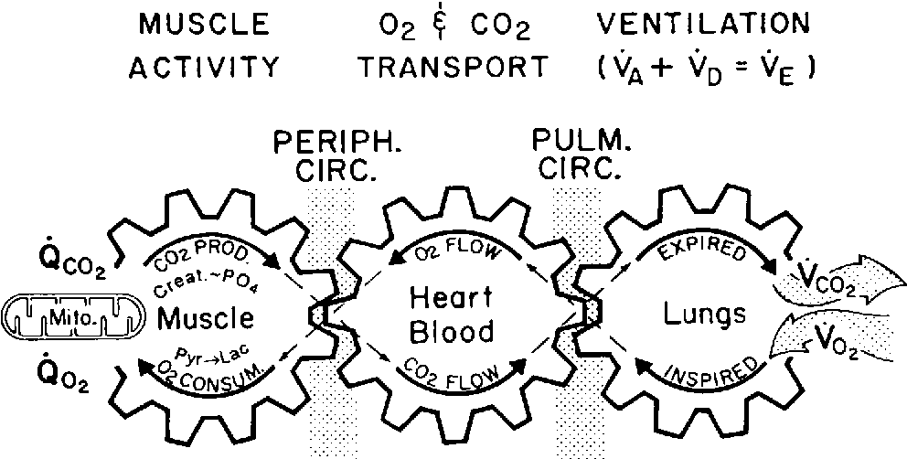
Hypercapnic Respiratory Failure
Definition: Higher PaCO2 in the blood than it should be
Cause: not enough alveolar ventilation for CO2 production
Near synonyms:
Ventilatory Failure
Type 2 Respiratory Failure
Hypoventilation
Hypercapnia
Except for REM sleep, our bodies keep PaCO2 within 3-5 mmHg despite huge changes in CO2 production
Build up here = CO2 in blood rises
Notes:
Hypercapnia Graphic
Wasserman, Karlman, et al. "Principles of exercise testing and interpretation." Journal of Cardiopulmonary Rehabilitation and Prevention 7.4 (1987): 189.

Slide 5
Causes of Hypercapnic Respiratory Failure
Mechanisms:
Decreased drive to breathe (OHS, Opiates)
Increase need for ventilation (Obesity)
Inefficient pulmonary function (Lung diseases)
Muscle or inefficient weakness (NMD, COPD)
Increased respiratory system loads
Airway resistance (OSA, COPD)
Stiff lungs or chest wall (Obesity)
Frailty:
Achievable ventilation ~= Acquired ventilation
Drive to breathe is not stable / reliable
Achievable Ventilation
Required Ventilation

Slide 6
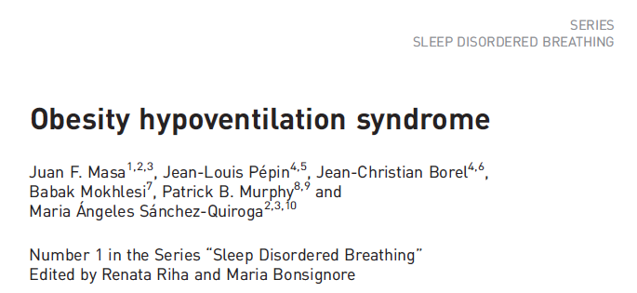
How common is outpatient hypercapnia?
There is 0 data on prevalence of outpatient all-cause hypercapnia.
Why? Fewer data sources, ABGs are invasive, less morbid population
Based on low identification rates; still high NIV prescription: OHS is probably most common
Fermi Estimate of Prevalence: 1 in 260 US adults
7.6% of adults US population BMI 40+
Rate of mod+ OSA in BMI 40+ = ~ 50%
Rate of OHS in mod+ OSA = ~10%
Notes:
The CDC estimated that 7.6% of the adult U.S. population has a BMI ≥40 kg/m² (https://pubmed.ncbi.nlm.nih.gov/29922829/).
Bariatric surgery screening for OHS:
Tran, Wang, Gharaibeh, et al.: Bariatric Surgery Risk in Obesity Hypoventilation - A total of 1,718 patients undergoing polysomnography with end-tidal CO2 monitoring prior to bariatric surgery at Cleveland Clinic from September 2011 to September 2018 were included.”
Key Findings: “OHS prevalence was 68.4%. Unadjusted analyses revealed a 1.5% increased odds of OHS (1.01; 1.00-1.03) per 1-unit BMI increase, 1.7% (1.02; 1.01-1.02) per 1% increase in sleep time Sa_{O2} < 90%, 12% increase (1.12; 1.03-1.22) per 1-U increase in hemoglobin A1c, and 3.4% increased odds (1.03; 1.02-1.05) per 5-U increase in apnea-hypopnea index. The association of apnea-hypopnea index with OHS persisted after adjustment for age, sex, race, and BMI and its comorbidities (1.02; 1.01-1.04)”

Slide 7
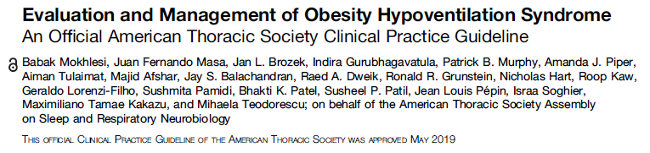
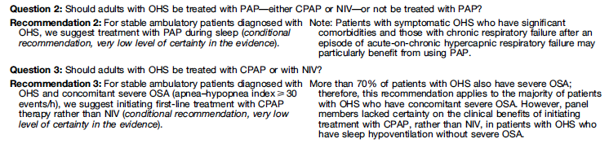
Guidelines
Body mass index above 30 kg/m²
Awake PaCO2 above 45 mmHg at sea level
Exclusion of other causes of hypoventilation*

Slide 8
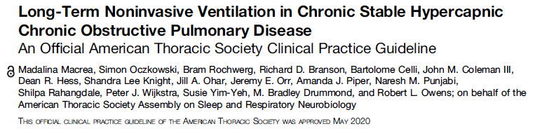
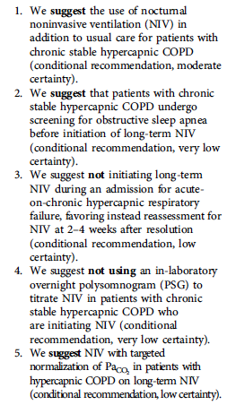
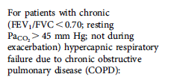
COPD
13 RCTs; NIV vs std care
Mortality risk: RR, 0.86; 95% CI, 0.58 to 1.27;
Decrease in hospitalizations: mean difference, 1.26 fewer; 95% CI, 2.59 fewer to 0.08 more hospitalizations
Improved QOL: standard MD [SMD], 0.48; 95% CI, 0.09 to 0.88
improvement in dyspnea SMD, −0.51; 95% CI, −0.95 to −0.06
Notes:
“To date, no studies have directly examined the timing of resolution of hypercapnia after an acute exacerbation to determine optimal timing of initiation of long-term NIV: https://www.atsjournals.org/doi/full/10.1513/AnnalsATS.202009-1171AG .

Slide 9
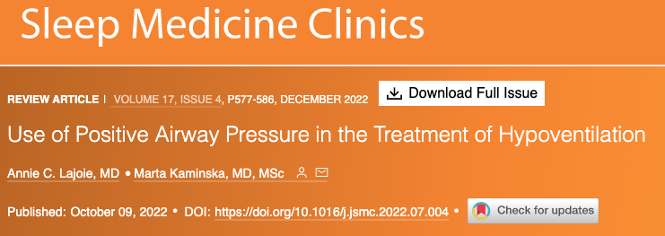
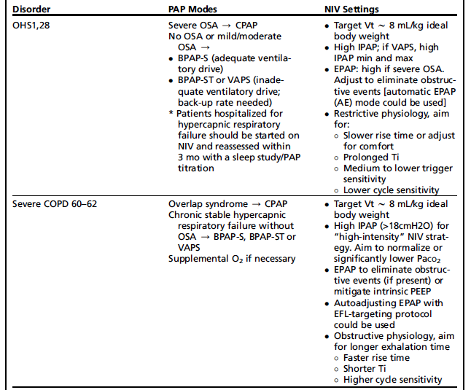
Notes:
https://bmjmedicine.bmj.com/content/1/1/e000146 --> lots of good info here.

Slide 10
How often do patients fall into a group with evidence-based of treatment?
Cause | Treatment | Outcome Improved | LOE (Cochrane or ATS) | Criteria (*Resmed)
Restrictive Thoracic Dz | NIV | Hospitalization, Mortality | Meta-analysis of 3+ 3(mixed) RCTs Low | ABG w/ PaCO2 over 45 Sleep oximetry SpO2 < 88%
OHS | CPAP or BiPAP | CO2, O2, ED visits, and mortality. | Meta-analysis 3 RCTs , 12 nonrandomized studies, Low | CPAP: Sleep study BiPAP: PaCO2 awake > 45 mmHg and FEV1 > FVC 70%
COPD | NIV | CO2, Hospitalization, QOL, dyspnea | Meta-analysis of 14 RCTs Moderate | PaCO2 over 45 or 52 Sleep oximetry SpO2 < 5 minutes on 2L or usual O2 OSA excluded or CPAP tried 2-4 weeks recovery from exac.
Neuromuscular Dz | NIV | Hospitalization, Mortality | Meta-analysis of 4+3 (mixed) RCTs Low | ABG w/ PaCO2 over 45 Sleep oximetry SpO2 < 88% MIP < 60cmH2o or FVC < 50%
*few trials of patient important outcomes in overlap syndromes have been done.
Notes:
We can extrapolate from these patients, though often payors do not want to. And these treatments are expensive.
COPD https://www.atsjournals.org/doi/full/10.1164/rccm.202006-2382ST
OHS: https://pubmed.ncbi.nlm.nih.gov/31726017/
Neuromuscular and chest D/O https://pubmed.ncbi.nlm.nih.gov/25503955/
https://document.resmed.com/documents/articles/1010293_RAD_Guidelines.pdf
What percentage of people who come in to the ICU meet those criteria?
Logistical problems: how many people get assessed if they do?
What other options are there? Pharm, etc.
GDMT
Compare to decompensated heart failure or decompensated heart failure
In a way, this is decompensated pulmonary failure.

Slide 11
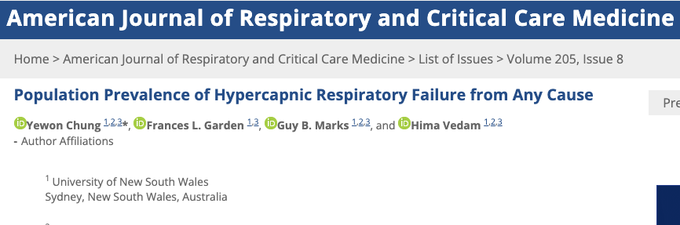
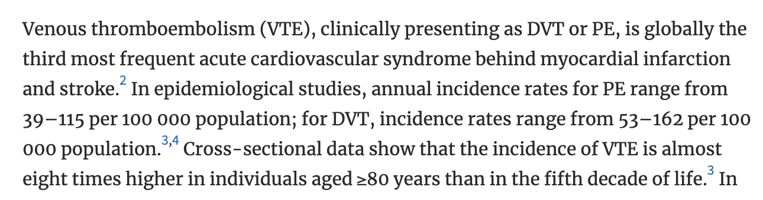
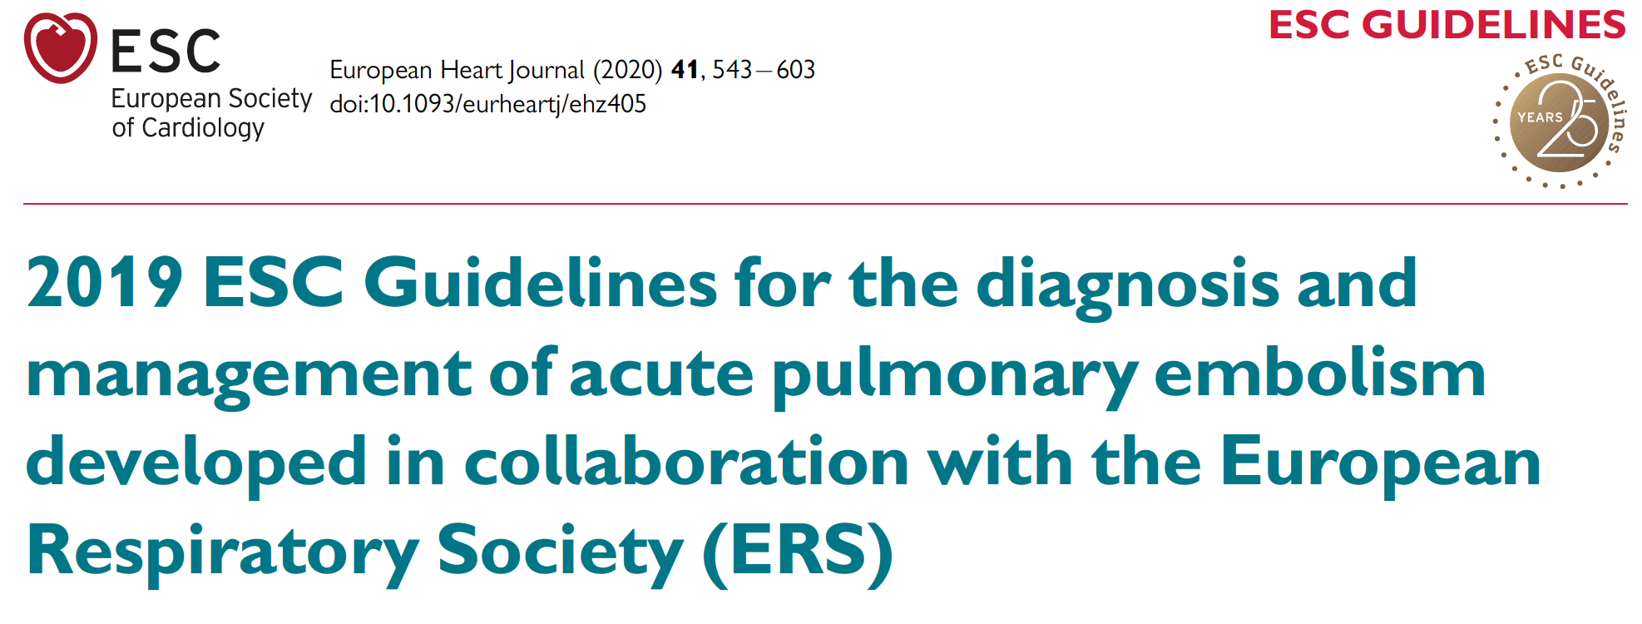
How common are admissions with hypercapnia?
2022: Liverpool AUS, 1 regional hospital services the entire district
Identified by initial ABG (w/n 24h) PaCO2 over 45, excluded iatrogenic causes/sedation. N=891 people, 1135 blood gasses (repeat hosp.)
Normalized rates of hypercapnia to population demographics
150 per 100,000 person/year
Acidosis in 55%.
For Comparison:

Slide 12
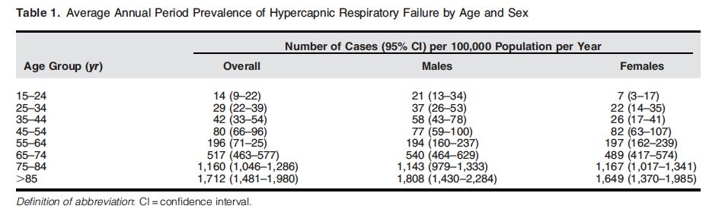
Support for frailty framework
Frailty:
Achievable ventilation ~= Acquired ventilation
Drive to breathe is not stable / reliable
Compared to Age 45-54:
RR 55-64: 2.1
RR 65-74: 6.2
RR 75-84: 15.7
RR 85-94: 26.2
Notes:
https://www.atsjournals.org/doi/full/10.1164/rccm.202108-1912LE?af=R
Limitations: unable to assess comorbidities or causes
Blood gasses may undersampble

Slide 13
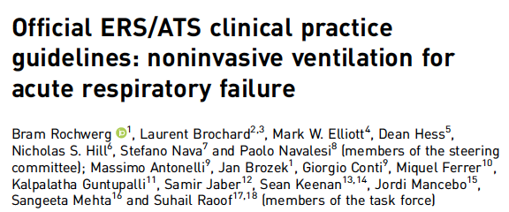
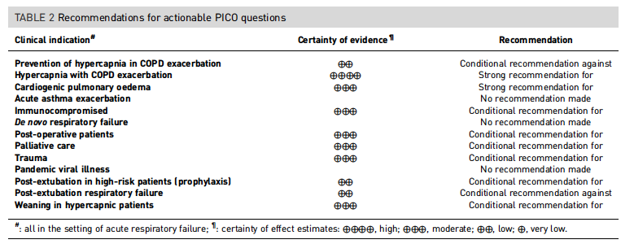
Acute Exacerbations: guidance for inpatient management
NIV: Well Supported
Acute outcomes are very good
What we do after the inpatient admission is the unresolved question.
More subsequent data supporting these indications

Slide 14
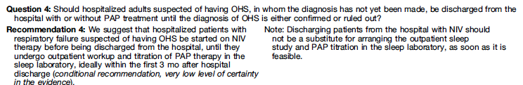
Post-exacerbation Management: OHS
30-70% of cases are diagnosed during an acute exacerbation (ERS)
Notes:
ERS summary: https://err.ersjournals.com/content/28/151/180097
Either diagnosed at:
1. 30-70% diagnosed during respiratory decompensation, often not at the first one. (Reportedly, affects 50% of hospitalized patients with BMI over 50) 9, 26, 29, 60, 69
2. Or at the time of escalation outpatient care to a pulmonologist or sleep medicine physician. (Presentation resembles OSAS)
The cohorts (depending how they are identified) seem to have significant differences
ERS 2016 Recommendations:
“Statements
1) Most Task Force members screen obese patients for OHS by sampling of blood gases (B), nocturnal transcutaneous PCO2 and/or determination of serum bicarbonate during wakefulness (C).
2) Increases in PaCO2 or capillary PCO2, or marked elevations of transcutaneous PCO2 (as compared to baseline) during REM sleep indicate OHS (B).
3) CPAP failure is higher in OHS as compared to OSAS (B).
4) NIV during sleep improves hypoventilation, sleep, QoL and survival. NIV is superior to lifestyle counselling (B).
5) OHS is associated with impaired ventilatory responses to hypercapnia and hypoxia, and increased cardiometabolic morbidity, which can be improved under NIV (B).
6) NIV with pressure support and target volume ventilation are both effective. Comparative studies do not show superiority of one mode (B).
7) Adherence of >4 h per day to NIV is crucial for improving hypercapnia (B).
8) Monotherapy with oxygen reduces ventilation and increases hypercapnia. Oxygen should only be applied as an adjunct to NIV (B).
9) Bariatric surgery reduces body weight, improves lung function and normalises blood gases (C).”
Priou P, Hamel J-F, Person C, et al. Long-term outcome of
noninvasive positive pressure ventilation for obesity hypoventilation
syndrome. Chest. 2010;138(1):84-90.
Pérez de Llano LA, Golpe R, Ortiz Piquer M, et al. Short-term and
long-term effects of nasal intermittent positive pressure ventilation
in patients with obesity-hypoventilation syndrome. Chest. 2005;
128(2):587-594.
ATS 2019: Short-term rates of hospitalization were reduced by PAP, but the event rate was low and data were reported in only one RCT (19). Longer-term data suggest high rates of hospitalization in patients with OHS on PAP but without a comparison group (data from five observational studies: 10% at 3 mo to 49% at 5 yr) (20, 22, 65, 70, 74).
19 – Masa, thorax: https://www.ncbi.nlm.nih.gov/pubmed/27406165/
20 – Masa, lancet https://www.ncbi.nlm.nih.gov/pubmed/30935737/
22 - https://www.ncbi.nlm.nih.gov/pubmed/27852952/
65 https://www.ncbi.nlm.nih.gov/pubmed/16100142/
70 https://www.ncbi.nlm.nih.gov/pubmed/26648713/
74
https://scholar.google.com/scholar_lookup?journal=Eur+Respir+J&title=Results+of+non-invasive+ventilation+in+patients+with+acute+hypercapnic+ventilatory+failure+and+obesity+hypoventilation+syndrome+(OHS)&author=JF+Sanchez+Gomez&author=A+Pacheco&author=G+Zamora&author=JM+Benitez+Moya&author=A+Valido+Morales&volume=40&publication_year=2012&pages=2042&

Slide 15
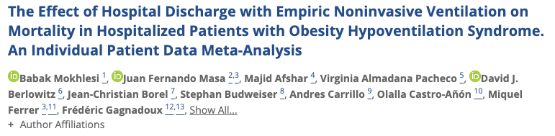
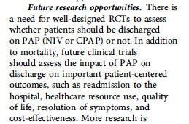
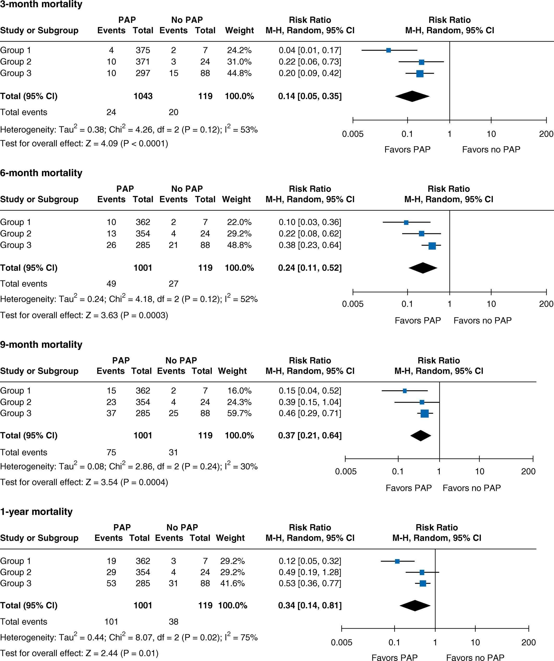
No RCTs have addressed this question
10 observational studies (3 studies of hospitalized cohorts, 6 with hospitalized subgroups); serious risk of bias.
“After adjusting for age, sex, and baseline Pa_{CO2}, the odds ratios (ORs) for [90-day] mortality were significantly lower in the group discharged on PAP (adjusted OR, 0.16; 95% CI, 0.08–0.33)”

Slide 16
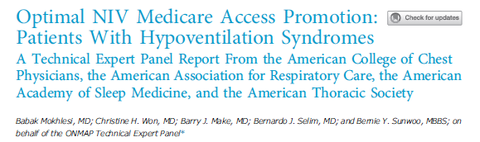
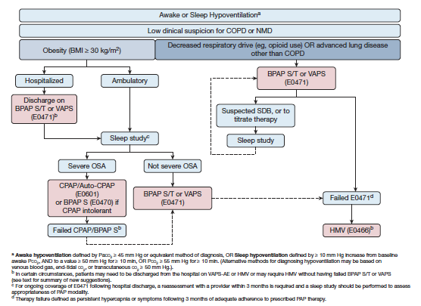
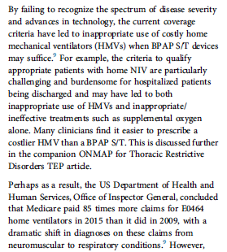

Slide 17
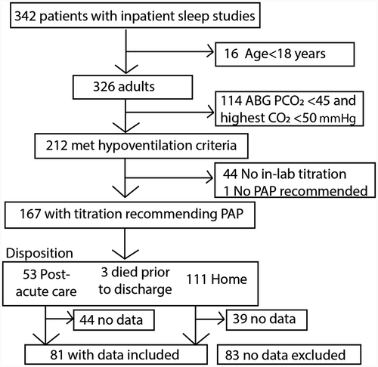
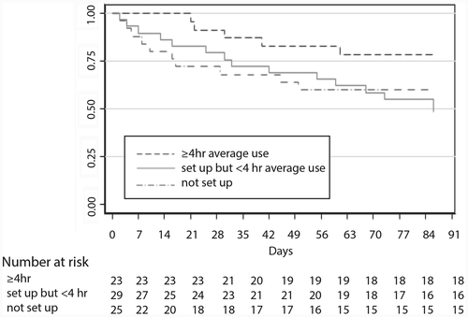
Inpatient Diagnostic Pathway for S.D.B. w Hypoventilation
“Because arterial blood gas (ABG) was not available on all patients, we utilized a broad definition of hypoventilation defined as ABG during index admission with partial pressure of carbon dioxide (PCO₂) ≥ 45 mmHg or end-tidal CO₂ (ETCO₂)/transcutaneous CO₂ (TCCO₂) during PSG ≥ 50 mmHg for at least 10 minutes”; inpatient sleep study requested by medicine team or pulm/cards consult.
Retrospective Review
Most frequently OHS or HFpEF
Admitted with CHF exac, COPD exac, or other
90-day readmission was 19.5% in patients who were adherent to PAP therapy vs 55.5% in nonadherent patients (a 65% reduction). 20 of 45 (44.4%) excluded patients with hypoventilation had 90-day readmission.
Minimal matching and control for healthy adherer bias
Notes:
[ ] review this in more depth

Slide 18
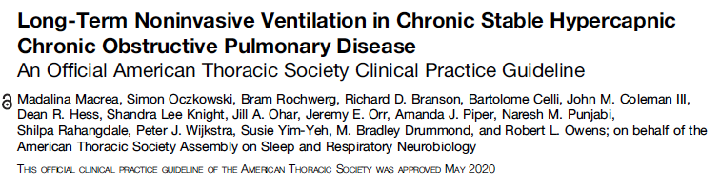
Do NOT start at hospitalization
wait 2-4 weeks to see if acute on chronic becomes chronic.
In-lab titration PSG not recommended for pure-COPD; attempt to normalize daytime pCO2.
AVAPS not better than PS
Notes:
NIPPV is now standard of care:
21. Macrea M, Oczkowski S, Rochwerg B, et al. Long-term noninvasive ventilation in chronic stable hypercapnic chronic obstructive pulmonary disease. an official american thoracic society clinical practice guideline. Am J Respir Crit Care Med. 2020;202(4):e74–e87. doi:10.1164/rccm.202006-2382ST
22. Ergan B, Oczkowski S, Rochwerg B, et al. European Respiratory Society guidelines on long-term home non-invasive ventilation for management of COPD. Eur Respir J. 2019;54(3):1901003. doi:10.1183/13993003.01003-2019
23. Murphy PB, Rehal S, Arbane G, et al. Effect of home noninvasive ventilation with oxygen therapy vs oxygen therapy alone on hospital readmission or death after an acute COPD exacerbation: a randomized clinical trial. JAMA. 2017;317(21):2177–2186. doi:10.1001/jama.2017.4451
24. Wilson ME, Dobler CC, Morrow AS, et al. Association of home noninvasive positive pressure ventilation with clinical outcomes in chronic obstructive pulmonary disease: a systematic review and meta-analysis. JAMA. 2020;323(5):455–465. doi:10.1001/ jama.2019.22343

Slide 19
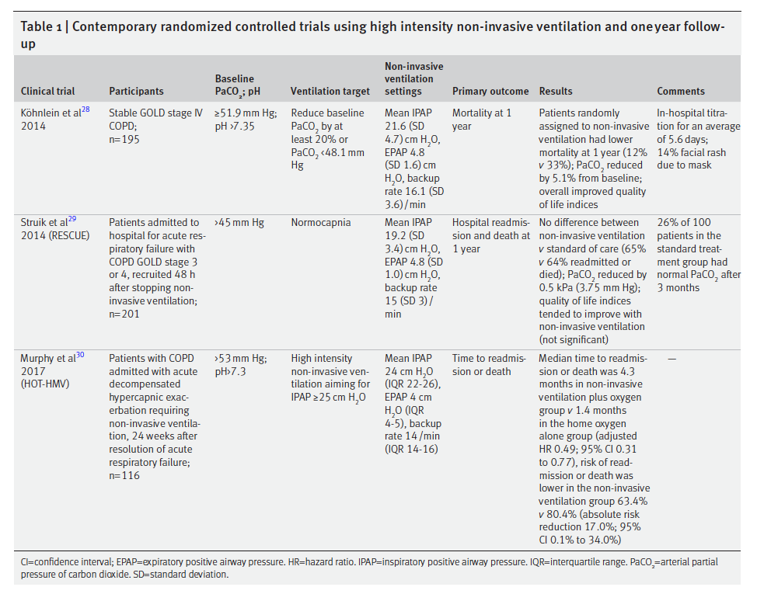
Post-AECOPD trials
Mode: BPAPS/T
Driving pressure
Timing of start after acute exacerbation
RESCUE vs HOT-HMV
(Not Post Exacerbation)
Many in control resolved hypercapnia
21% excluded at 2-4 weeks.
Notes:
RESCUE, 201 patients with COPD admitted to the hospital with acute hypercapnic respiratory failure who had persistent hypercapnia more than 48 hours after ventilatory support were randomly assigned to NIV or to no NIV.
---> no benefit in primary outcome of resp readmission or death at 12 months (though it did reduce CO2 and improve gas exchange)
--Struik FM, Sprooten RT, Kerstjens HA, Bladder G, Zijnen M, Asin J, Cobben NA, Vonk JM,
Wijkstra PJ. Nocturnal non-invasive ventilation in COPD patients with prolonged
hypercapnia after ventilatory support for acute respiratory failure: a randomised,
controlled, parallel-group study. Thorax 2014; 69: 826-834
HOT-HMV, 116 patients with severe COPD who received NIV during acute hypercapnic respiratory failure and who remained hypercapnic (defined as Pa_{CO2} > 53 mm Hg) 2–4 weeks afterward assigned to HOT + NIV vs HOT alone.
https://pubmed.ncbi.nlm.nih.gov/28528348/

Slide 20
Hypercapnia Trajectories
Assessment
2
Assessment 3
Increasing CO2
Assessment 1
Normal CO2 on labs
Normalization of Hypercapnia
Normal CO2 on labs
PaCO2 at discharge (not HCO3), Severity classification are associated with persistence (DOI: 10.1159/000524845)
High PaCO2 and Prior Acute NIV predict recurrence (DOI: 10.1111/resp.12652)
Hypercapnia on labs
Hypercapnia
Hypercapnia on labs
Acute Hypercapnic Respiratory Failure
Recurrent Hypercapnic Respiratory Failure
Chronic Hypercapnia
Acute on Chronic Hypercapnic Respiratory Failure
Common: COPD
Common: OHS
Notes:
Do we know much about the relative proportion of these arrows? No. Probably Recurrent Acute and Acute = over-represented by current methods to identify. Yellow types may be most of what gets diagnosed in sleep clinic (vs hospitalization)
Roughly 30% of OHS patients identified at acute decompensation based on: 83 Priou P, Hamel JF, Person C, et al. Long-term outcome of
noninvasive positive pressure ventilation for obesity hypoventilation
syndrome. Chest 2010; 138: 84–90.
Acute Hypercapnia well tolerated, much research into acute management exists
For COPD – Green vs brick arrows … in HOT-HMV, roughly ¼ of patients who met inclusion criteria at discharge were no longer hypercapnic after 2-4 weeks. Not known how frequently resolution is for other causes
For OHS overall, roughly 50/50 present as the green arrow and the yellow arrow. The green arrow has a much worse prognosis than the yellow arrow.
In UT: more blue and orange arrow than green and yellow because hypoxemia is apparent.

Slide 21
Timing of NIV: COPD vs OHS
“Guidelines for chronic hypercapnic COPD recommend a 2- to 4-week recovery period following hospitalization for COPD exacerbation before assessing for noninvasive ventilation to confirm that chronic hypercapnia is persistent (eg, PaCO₂ ≥ 52 mm Hg)”
This recommendation is derived from the fact that 21% of patients with COPD recruited for the Home Oxygen Therapy-Home Mechanical Ventilation (HOT-HMV) trial were excluded because the hypercapnia on discharge resolved after 2 to 4 weeks.
Conversely, the guidelines for OHS suggest hospitalized patients with OHS be continued on PAP therapy following hospital discharge until they undergo polysomnography, ideally within the first 3 months of discharge.⁶
This recommendation is driven by a mortality difference at 3 months postdischarge between patients with OHS discharged without PAP (16.8%) and with PAP (2.3%).¹⁴
Notes:
From:
https://jcsm.aasm.org/doi/10.5664/jcsm.9710
COPD guideline: Macrea M, Oczkowski S, Rochwerg B, et al.. Long-term noninvasive ventilation in chronic stable hypercapnic chronic obstructive pulmonary disease. An official American Thoracic Society clinical practice guideline. Am J Respir Crit Care Med. 2020;202(4):e74–e87.
OHS guideline Mokhlesi B, Masa JF, Brozek JL, et al.. Evaluation and management of obesity hypoventilation syndrome. An official American Thoracic Society clinical practice guideline. Am J Respir Crit Care Med. 2019;200(3):e6–e24.
14: Mokhlesi B, Masa JF, Afshar M, et al.. The effect of hospital discharge with empiric noninvasive ventilation on mortality in hospitalized patients with obesity hypoventilation syndrome. An individual patient data meta-analysis. Ann Am Thorac Soc. 2020;17(5):627–637.

Slide 22

???
No tx data
Limited epi data
Trial Data
Decent Epi
Few Cohorts
Some Epi
Trial Data
Decent Epi
COPD, Very Severe
COPD, mod severe
AHI 50 events/hr
COPD, mod severe
AHI 10 events/hr
Met. Alk loop diur
BMI 45 kg/m2
AHI 50 event/hr
PaCO2 52 mmHg
PaCO2 50 mmHg
PaCO2 50 mmHg
PaCO2 50 mmHg
Swap any combination of:
Muscular weakness
Obesity
Opiate use
Lung disease
Etc.

Slide 23
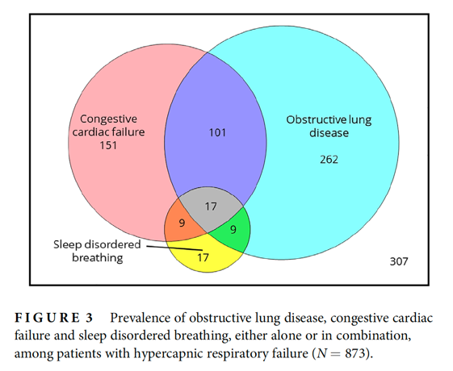
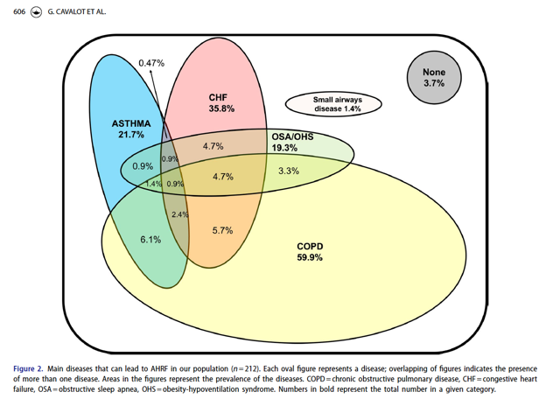
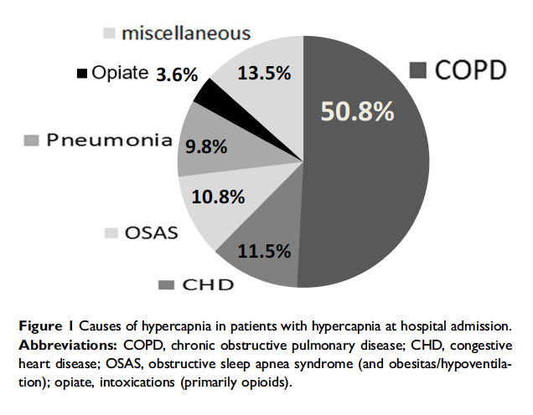
Who are “all-comers with inpt hypercapnia”?
All patients with dyspnea or pulm disease admitted to hospital received capillary blood gas (some screening with VBG). Stratified by pH > 7.35 or pH < 7.35
Hospital specializing in lung disease (unclear referral pattern):
Liverpool AUS: ABG w/n 24h of admission.
Diagnostic codes: 52% Charlson Comorbidity 5+; Prevalence-based estimates: NMD under-represented
Chung Y, Garden FL, Marks GB, Vedam H. Causes of hypercapnic respiratory failure and associated in-hospital mortality. Respirology. 2022
All adult ED visits @ single Toronto ED w ABG <7.35/45+ OR VBG <7.34/50+ & CEDIS resp code for resp symptoms. Charts reviewed for 12 months.
Giulia Cavalot, Vera Dounaevskaia, Fernando Vieira, Thomas Piraino, Remi Coudroy, Orla Smith, David A. Hall, Karen E. A. Burns & Laurent Brochard (2021) One-Year Readmission Following Undifferentiated Acute Hypercapnic Respiratory Failure, COPD: Journal of Chronic Obstructive Pulmonary Disease, 18:6, 602-611
Vonderbank S, Gibis N, Schulz A, Boyko M, Erbuth A, Gürleyen H, Bastian A. Hypercapnia at Hospital Admission as a Predictor of Mortality. Open access emergency medicine : OAEM 2020; 12: 173-180.

Slide 24
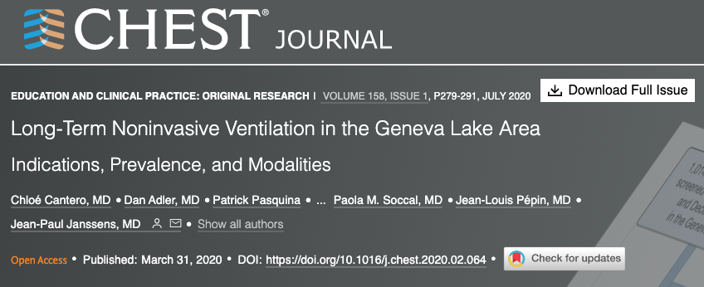
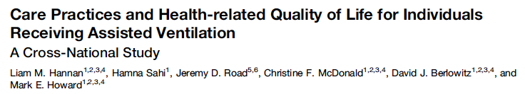
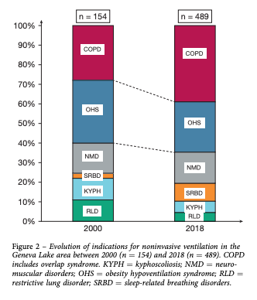
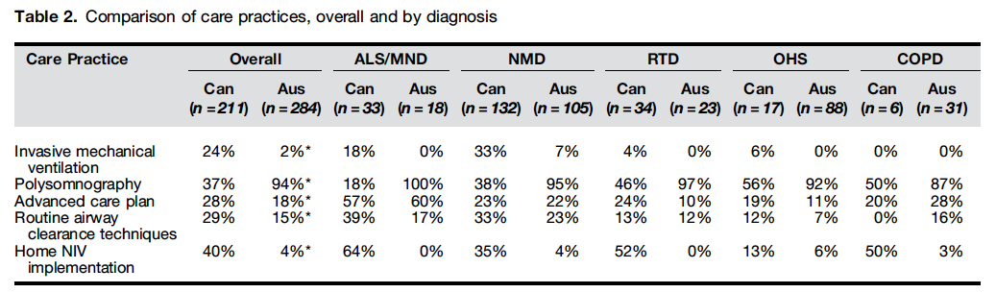
Who gets on NIV?
Registry of all patients: Lake Geneva area
2.5x increase from 2000→ ‘18
Victoria, AUS & British Colombia, CA.
Includes
OVS
Notes:
The HOmeVent Registry -> Germany; another source of similar information. E.g. prevalence of COPD. International Journal of Chronic Obstructive Pulmonary Disease 2019:14 2377–2384
“The population of patients under chronic NIV has also changed, from the initial predominantly restrictive indications (sequelae of TB, postpolio syndrome, chest wall disorders, and neuromuscular disorders) to a progressive increase of patients with chronic respiratory failure (CRF) because of obesity hypoventilation syndrome (OHS), COPD, and overlap syndromes which started in the late 1990s”
Obesity was highly prevalent: BMI was $ 30 kg/m2 in 270 patients (55%), $ 35 kg/m2 in 180 patients (37%), and $ 40 kg/m2 in 106 patients (22%).
NIV was initiated electively in 247 subjects (50%) vs in an emergency setting for 220 (45% of all patients; not specified for 22 patients; 5%). Most patients were started on NIV as inpatients (n ¼ 400; 82%) vs 73 (15%) as outpatients (not specified for 16 patients; 3%)
Geneva:
DOI: https://doi.org/10.1016/j.chest.2020.02.064
Also:
Home mechanical ventilation: Is there a change in prescription patterns in the last 10 years?
ERJ Open Research 2022 8: 41; DOI: 10.1183/23120541.RFMVC-2022.41
1 clinic in portugal: 2011 (175), 2016 (257), 2021 (495 patients)
More men, older patients.
45% in latest are OHS. COPD is also most common.

Slide 25
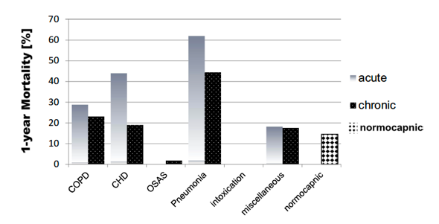
What does it matter?
32% 1yr mortality.
Only evaluated in-hospital outcomes
Chung Y, Garden FL, Marks GB, Vedam H. Causes of hypercapnic respiratory failure and associated in-hospital mortality. Respirology. 2022
At one year, 150 patients (70.8%) were readmitted and 19 (9%) had died.
Giulia Cavalot, Vera Dounaevskaia, Fernando Vieira, Thomas Piraino, Remi Coudroy, Orla Smith, David A. Hall, Karen E. A. Burns & Laurent Brochard (2021) One-Year Readmission Following Undifferentiated Acute Hypercapnic Respiratory Failure, COPD: Journal of Chronic Obstructive Pulmonary Disease, 18:6, 602-611
Vonderbank S, Gibis N, Schulz A, Boyko M, Erbuth A, Gürleyen H, Bastian A. Hypercapnia at Hospital Admission as a Predictor of Mortality. Open access emergency medicine : OAEM 2020; 12: 173-180.

Slide 26
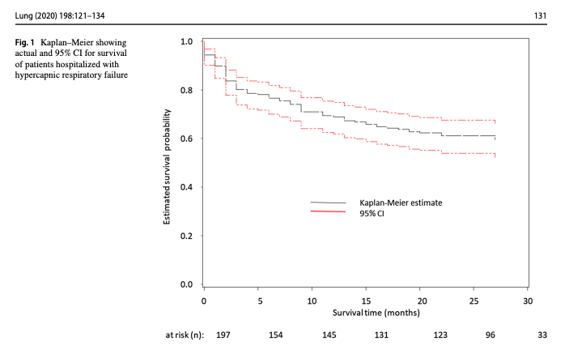
Admissions with hypercapnia indicate high risk of morbidity; may be driven by treatable conditions
↑ with PVD, active smoking, ILD and Bronchiectasis
increased with compensation (bicarb 40-49 vs 20-29)
Notes:
Exclusion of other causes of hypoventilation
Obesity -> increased CO2 production and vent limitation from mass of chest wall and disadvantaged respiratory mechanics
“Other Causes”: Obstructive lung disease, neuromuscular / chest wall disease, things that suppress ventilatory drive (opiates), or causes of metabolic alkalosis (loop diuretics)
Likely routine to you all, but this is often botched in pulmonary and inpatient medicine.
Exclusion parameter
In research studies: A patient with mild COPD cannot have OHS. In reality – what do you do with a patient who has COPD so mild that it doesn’t cause OHS? Or, if it’s mild enough that it wouldn’t cause hypercapnia on it’s own? Open questions, problem with the paradigm.
“Exclusion of other causes of hypoventilation
Severe obstructive respiratory disease
Severe interstitial lung disease
Severe chest-wall disorders (eg, kyphoscoliosis)
Severe hypothyroidism
Neuromuscular disease
Congenital hypoventilation syndromes”

Slide 27
Admitted to hospital (Floor or ICU) with ABG showing PaCO2 over 45 mmHg and pH 7.35-7.45
Collider bias
Notes:
Inclusion criteria: Admitted, 18+
ABG showing PaCO2 over 45 and pH 7.35-7.45 during 2018. N=491
44% had multiple admissions w/n the year
44.2% mortality over a median of 592 days
Manual review of 40 patients with 0 competing metabolic proceses.

Slide 28
Sleep Disordered Breathing and Obesity?
10.8% OSAS
5% dx’d obesity; 6% dx’d OSA
Chung Y, Garden FL, Marks GB, Vedam H. Causes of hypercapnic respiratory failure and associated in-hospital mortality. Respirology. 2022
OSA/OHS – 19.3%
Retrospective Reviews: mirrors what rate these are diagnosed (not what rate they present)
Giulia Cavalot, Vera Dounaevskaia, Fernando Vieira, Thomas Piraino, Remi Coudroy, Orla Smith, David A. Hall, Karen E. A. Burns & Laurent Brochard (2021) One-Year Readmission Following Undifferentiated Acute Hypercapnic Respiratory Failure, COPD: Journal of Chronic Obstructive Pulmonary Disease, 18:6, 602-611
Vonderbank S, Gibis N, Schulz A, Boyko M, Erbuth A, Gürleyen H, Bastian A. Hypercapnia at Hospital Admission as a Predictor of Mortality. Open access emergency medicine : OAEM 2020; 12: 173-180.

Slide 29
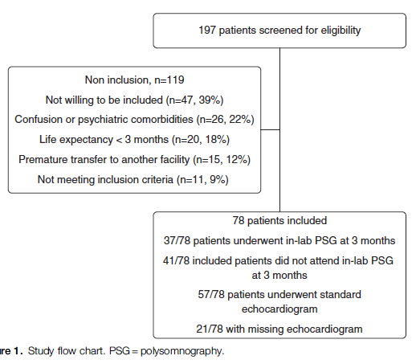
Why does this matter to sleep provider?
Excluded NMD, iatrogenic, or with persisting confusion
21% had been hospitalized in the last year for resp failure.
Patients who were not treated for OSA had higher readmissions
 | COPD (66%) | No COPD (33%)
AHI Median [IQR] | 31.9 [14.3, 45.6] | 66.0 [48.0, 83.8]
AHI > 15 present | 66% | 94%
AHI > 30 present | 51% | 81%
Notes:
https://www.atsjournals.org/doi/pdf/10.1164/rccm.201608-1666OC
[ ] Review details

Slide 30
& No prior OSA Dx
Overall prevalence of OSA ( AHI > 30 ) in survivors over 50%
Notes:
Admitted to ICU to 1 ICU in Tunisia 2015-2018, PaCO2 > 6kpa = 45 mmHg, pH < 7.35. No prior OSA syndrome diagnosis.
make the point that the reverse probabilities are difficult to reason about: likelihood of a given person with OSA needing ICU care? Low. Likelihood of a given person needing ICU care having OSA? High (if that ~50% study is to be believed, severe OSA = at least 10 fold increase)
Is 50% beyond the treatment threshold for CPAP?

Slide 31
Our Research
De-identified, patient-level data (not PHI, though recommended to be treated as such)
Federated data from medical center EHRs
Center for High Performance Computing protected environment
We are only using cross-sectional (1-encounter) data
Data Available | Data unavailable
Demographics Diagnosis Medications Procedures - what procedures were done. E.g. sleep study code Labs Cancer registry (NAACCR) Allergies Death Recoreds* (in progress) | Some notes* Diagnostic reports DICOM image objects Providers Departments/clinics

Slide 32
Data Request
Age > 18; Admission between 1-1-2018 and 9-28-2022
An ICD code for Hypercapnic RF; ABG calendar day of admission with PaCO2 over 45 mmHg.
Dataset: 925,512 patients from 70 Healthcare organizations
80+ gb of data; 1.2 Billion ‘facts’ in medications alone.
Exclude: entries where any data element (demographics, lab tests, diagnostic codes, procedure codes, medications, vital signs) is empty to ensure complete data.
Exclude: all repeat admissions

Slide 33
Patients:
 | Total | ABG Group | ICD Group
 | N=118,981 | N=80,178 | N=35,517
Age | 64 (±14) | 64 (±14) | 64 (±14)
Female? | 47% (55,838) | 45% (36,056) | 51% (18,219)
Asian | 1% (1,170) | 1% (839) | 1% (311)
Black | 22% (25,755) | 20% (16,195) | 25% (8,928)
Native American / Alaska Native | 0% (338) | 0% (194) | 0% (135)
Native Hawaiian / Pacific Islander | 0% (87) | 0% (51) | 0% (34)
White | 71% (84,585) | 72% (57,988) | 68% (24,190)
Latino | 3% (3,211) | 3% (2,053) | 3% (1,095)
Location
midwest | 17% (20,797) | 16% (13,137) | 18% (6,492)
northeast | 30% (35,937) | 32% (25,348) | 30% (10,556)
south | 50% (58,988) | 51% (41,087) | 45% (15,918)
west | 3% (3,259) | 1% (606) | 7% (2,551)
n=118,981 first hypercapnia admission
~60% have ABGs; 35% have VBGs. 99%+ have BMPs, CBCs
Vital signs: 80% with BP, 30% with RR charted

Slide 34
Comorbidities
74,977 of 118,981 (63%) have at least 1 of: COPD, CHF, OSA
35% have OSA
17% Asthma; 33% nicotine dependence
5% NMD; 6% OUD; 8% dementia

Slide 35
Inpatient Management
56% have critical care services billed
24% have a TTE performed; 17% have a CT of the chest
52% with acidemia (<7.35 pH); higher likelihood of critical care (OR 1.77)
CHF (OR 0.82) and OSA (OR 0.93) less likely academic
More preventable?
COPD (OR 1.16), CKD (1.21), and OUD (1.10) more likely

Slide 36
Who do guidelines apply to?
Based on diagnostic codes present
ATS OHS Guideline (2019): 28,337 (24%)
ATS COPD NIV Guideline (2020): 17,960 (15%)
Neither guideline: 61%

Slide 37
Limitations and next steps
All single-encounter data due to data quality
Will look at intubation and NIV inpt rates; hopefully LOS
Can’t evaluate readmissions, mortality, outpatient management.
Data quality: contingent on local practices (hard to assess)
Next Steps
Will evaluate how cohort definitions differ (last year’s Sleep GR)
Will characterize patients using clustering: ?identify useful endotypes
Request expanded data-set including patients without hypercapnia to evaluate features that correlate with presence of hypercapnia.

Slide 38
Roadmap & Learning Goals
What is hypercapnic respiratory failure?
What guidelines say to do with hypercapnic respiratory failure?
Goal: Understand limitations on current guidelines to the management of all-comers with hypercapnic respiratory failure.
Who gets hypercapnic respiratory failure?
Goal: What is known and unknown about the role of obesity and OSA
Current Research
How could we do it better?
Notes:
Last year: Bicarbonate, rates of missed diagnoses (high), cohort study definitions

Slide 39
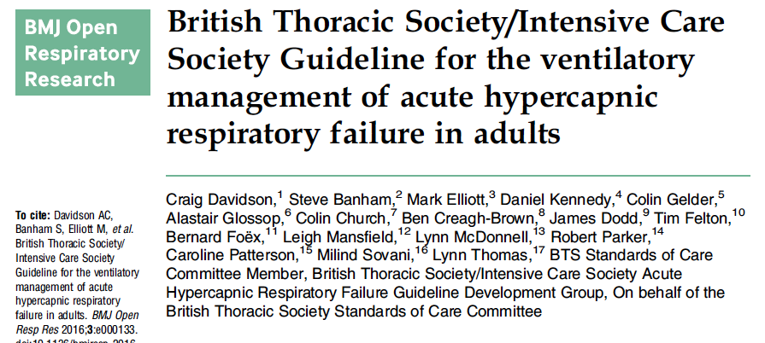
All-comers with Decompensated Hypercapnia?
“For non-COPD patients recovering from an episode of AHRF, a referral to a home ventilation service for assessment of ‘domiciliary NIV use’ has been recommended, while continuing ‘nocturnal NIV’ till to the accomplishment of the evaluation.
“Good practice point”, not recommendation based on empiric data
What about other management strategies? (Acetazolamide, vascular congestion management, pulmonary rehab… )
Notes:
Maybe move this to after?

Slide 40

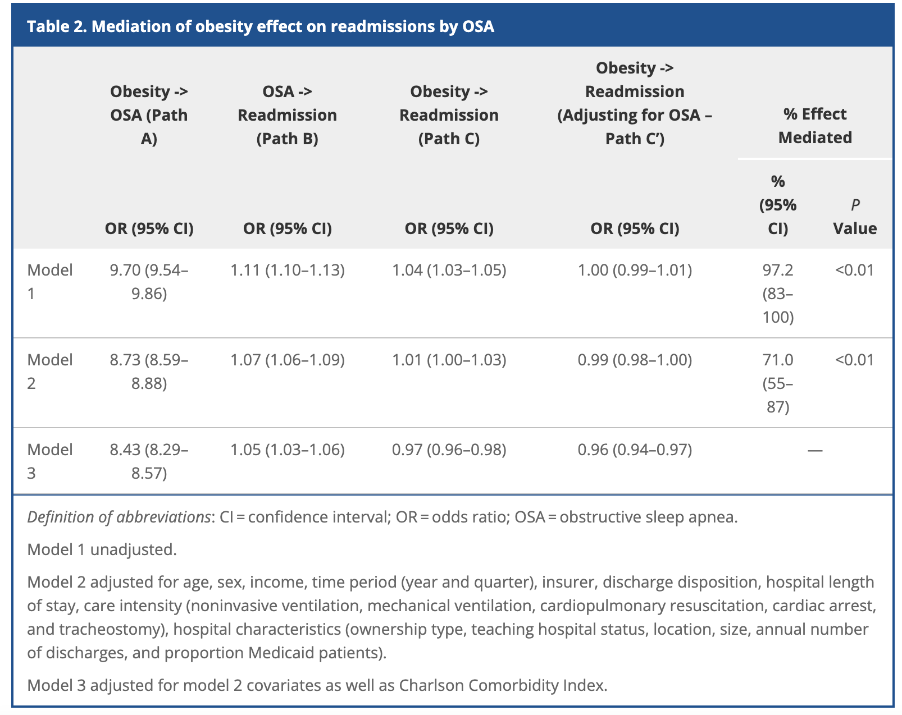
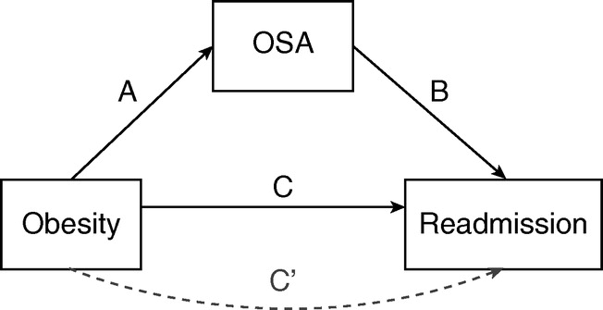
Medicare Nationwide Readmissions Database 2010-2016: 1.6 million COPD admissions
71% of readmission risk from obesity was attributable to OSA.
Critique: correlative methods, no severity
Notes:
Mediation analysis methods blurb:
Mediators are intermediate variables located in the causal pathway between the exposure and the outcome, that account for the effect of the exposure on the outcome. Although mediators are conceptually different from confounders, this distinction cannot be made purely on statistical or mathematical grounds (44). Mediation analysis, however, does not prove causation. Rather, it quantifies the extent to
which the association between exposure and outcome is accounted for by a third variable.
Crucially, the associations between exposure and mediator or mediator and outcome are also
potentially susceptible to confounding
Overlap syndrome mediates the relationship between obesity and COPD readmission
https://www.thoracic.org/members/assemblies/assemblies/srn/journal-club/effects-of-obstructive-sleep-apnea-and-obesity-on-30-day-readmissions.php
PubMed: 34624200
Critiques: no ability to tease out severity relationship which may differ.
Are some of the patients diagnosed with COPD actually OHS or similar

Slide 41
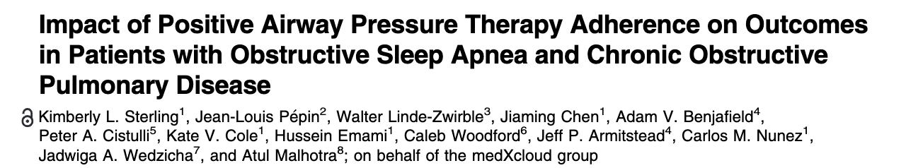
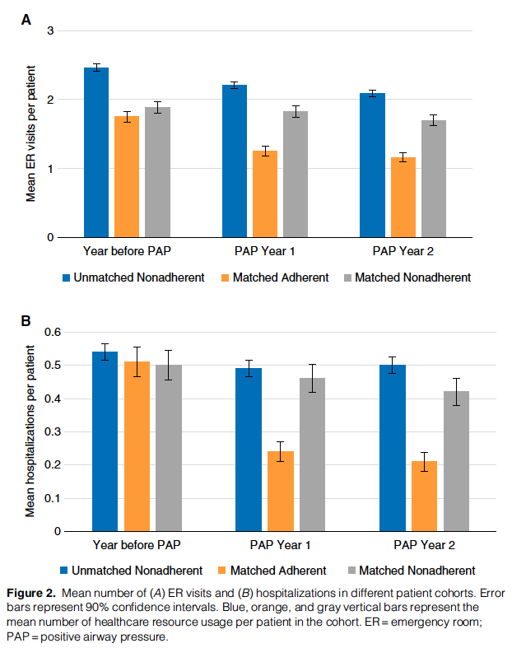
Resmed & Inovalon Insights, LLC payor claims database: 6810 pts with a COPD diagnostic code in the year before device set up
Matching: sex, comorbidities, COPD-related HC usage in prior year
Propensity score for CPAP adherence
Outcomes: ↓ER Visit and Hospitalizations
Critique: healthy adherer bias
Notes:
DOI: 10.1164/rccm.202109-2035OC Sterling, Pepin, Linde-Zwirble, et al.: PAP Adherence and Outcomes in Overlap Syndrome

Slide 42
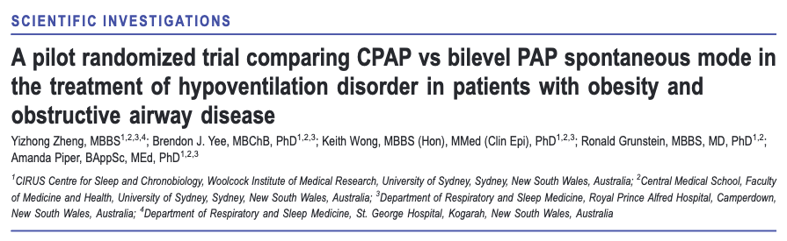
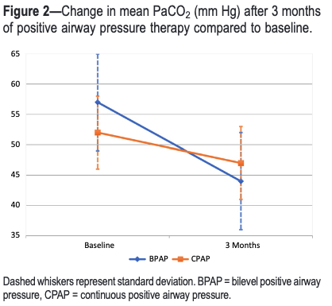
N=32 RCT: BPAP-S vs CPAP
Patients: OSA (AHI 59), BMI (43), PAP Naïve, No NMD, and COPD/Obst (FEV1 48% pred)
80% Power to detect 𝚫7 mmHg PaCO2 at 3 months
Avg 15.8/9.7 BPAP; 12.7 CPAP
Better spiro and SF-36 cog in BPAP group, but not powered for that

Slide 43
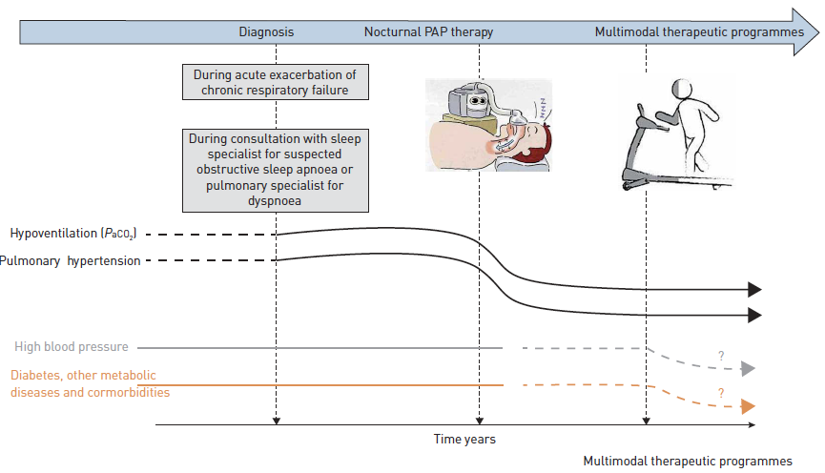
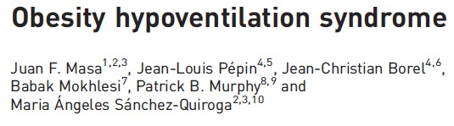
What do we do about the multiple component cause folks?
Generalize? But does this work?
“This patient is mostly OHS” → BiPAP or CPAP immediately
“This patient is mostly COPD” → wait 2-4 weeks before NIV
“Off-label”: can do for medications
Payors? They want evidence to pay for machines

Slide 44
Leaky Pipeline from admission to treatment
Presentation With Hypercapnia
Hypercapnia is common, highly morbid, and likely increasing in frequency
Correctly Recognized?
Inpt Hypercapnia is frequently missed in practice
Marik, JICM 2012: 75% error rate.
Causes Correctly Diagnosed?
Many patients do not receive definitive testing
SDB: 30% vs 60-75%
Is there data to guide treatment?
We don’t know what to do for many (most?) patients with hypercapnia
No good estimate
Is it logistically possible?
Device qualification restrictions.
No good estimate
Does it happen?
Requires coordination between Inpt → Outpt. Consider CHF (CMS f/u after discharge)
No good estimate
Notes:
Patients prone to ventilatory decompensation are not currently systematically identified or managed, and so frequently fall through the cracks. Identification and treatment of sleep disordered breathing and its risk factors is a promising approach to improve care but requires empiric support to justify implementation.
Motivation for the research Dash systematized, identification, and assessment, with a battery of a valuations is likely to lead to a large improvement in readmission. Include this as the reason to do this research. It’s needed because this is common and commonly missed and highly morbid.
[x] https://onlinelibrary.wiley.com/doi/10.1111/resp.14413 editorial on hypercap epidemiology.. highlights need for better methods than ABG to identify. This can be a key citation.
“Tertiary prevention refers to the action taken to reduce the chronic effects of a health problem in an individual or a population by minimizing the functional impairment consequent to the acute or chronic health problem”
My vision: someone comes in with hypercapnia - they are identified as someone who for some reason has frailty of their ventilatory control or performance and thus at high risk of future adverse outcomes. This triggers a number of assessments to identify the causes for this frailty, and triggers a pipeline for respiratory care (both diagnostic studies and outpatient treatment.
Current reality: referral to sleep medicine in placed. They receive steroids, antibiotics, diuretics and slowly improve. They are sent home on oxygen and bounce back.
Why are we doing it?
Prevalence if hypercapnia is likely rising: Obesity, Opiates, Multi-morbidity
What are the most common component causes? Not known
Existing evidence pertains to well-defined populations that do not reflect clinical practice
No consensus exists around how to systematically identify, nor manage these patients after stabilization.
HUGE room for improvement in processes of care, but evidence is required.

Slide 45
What is ‘hypercapnic respiratory failure’?
Problems with PaCO2 > 45 mmHg (sea-level, current def)
97.5 Percentile of ‘normal’?
“Hypercapnic respiratory failure is a syndrome”
Syndrome (Greek: ‘con-currence’) = a set of signs and symptoms that together suggest a common cause.
Yet PaCO2 = Lab finding (hypercapnia). Gap?
If there is no agreed-upon reference standard test: perhaps ‘construct’ is a better term.
2 instrumental uses:
Classification: e.g. “Hyperlipidemia”
Prediction: “10-y ASCVD risk”
Ideal Definition:
Who is at risk for future/ongoing ventilatory failure?
Who will respond to treatments?
Notes:
What is our ‘reference standard’?
2. The test is not the truth (Scott’s post - https://www.statusiatrogenicus.com/2019/05/the-test-is-not-truth-one-week-in-life.html)
3. ‘Construct’ of ventilatory failure? (=gives shared language to understand)
4. Classification vs Prediction tasks.
‘Severe and persistent hypercapnia, termed hypercapnic respiratory failure, is defined as
chronically high PaCO2 (>45 mmHg) [5].’
Budweiser S, Jörres RA, Pfeifer M. Treatment of respiratory failure in COPD. Int J Chron Obstruct Pulmon Dis
2008; 3: 605–618.
—> interesting to note that there is usually no specification on how long “persistent” is required to be.
The word “syndrome” (from Greek language:
συν-δρóμος meaning “con-currence”) denotes a clinical presentation of different phenomena that together invoke a common cause on which the eventual diagnosis is established. However, this expression may introduce a bias when a cause is inferred but cannot be proven.
Causal inference may be spurious when clinical manifestations are non-specific, as in OSA. In that case, a gold-standard reference test is needed to demonstrate that the presumed cause is present. If such a test is not available, the “syndrome” definition has no solid foundation and the disease construct may be nothing more than a black box.
There is a risk of lumping conditions it should be lumped. Which could be a hindrance to discovering how to manage individual patients. However I would argue that even if that is the case, lumping the syndrome together can be very helpful to improve recognition processes of care. As an example how it operates sepsis, which in the last 30 years of research has not healed any strong evidence positive recommendations, but it’s been huge benefit for improving processes of care.
Is it an epiphenomema? How does this relate to syndrome vs disease?
‘Construct’ of ventilatory failure? (=gives shared language to understand
Classification: e.g. you have high cholesterol or not?
Prediction: e.g. your risk of ASCVD in 10 years is __? –ARR warrants statin
A prediction-based construct: better for clinical care and trials, more slippery
What would we be predicting? Abstrct: future respiratory failure. Operational: death, readmission, or activity limitation from ventilatory respiratory failure
“The majority of ML applications in medicine are still using classification 8 methods rather than risk prediction. It is time for researchers to realize that classification provides limited information, is arbitrary, is more prone to patient sampling issues, and is at odds with medical decision making.” From https://discourse.datamethods.org/t/observations-on-big-data-precision-health-and-machine-learning/6061
Example of PFTs: attempting to move toward
Place to take this? Prospective definition vs cross sectional definition of hypercapnia as per here https://www.atsjournals.org/doi/full/10.1164/rccm.202204-0628LE
Define hypercapnia in terms of the increased risk of morbidity (like pHTN).
Consider Framingham as a prediction that usurps the diagnosis of HLD. Analogous concept of prediction of respiratory frailty?
Is “Hypercapnic Respiratory Failure” too heterogenous to study?
Studying ’syndromes’ haven’t been particularly fruitful
Proposed paradigm -> moving toward precision in defining the heterogeneity: will it be based on physiologic, epidemiologic, microbiologic criteria?
https://www.nature.com/articles/s41591-022-01843-x#Fig1
“The capacity to oxygenate and ventilate actively metabolizing tissue depends
upon three key factors: prudent regulation, reserve capacity, and tissue adaptability
to any sustained shortfall” Marini DOI: 10.1097/CCM.0000000000005022
Servo control = automatic control system that takes a mechanical position or angle as the control object.
https://www.nature.com/articles/s41591-022-01843-x#Fig1 –
Argue to separate syndromes into:
Insult that can possibly lead to the syndrome: what is the physiologic disturbance?
Treatable trait: physiology identifiable by biomarkers (or other identifiable features) that predicts response to treatmen
Requires trials that enroll on the basis of treatable traits.

Slide 46
Research Aims:
Who are these patients with hypercapnic respiratory failure?
How should we best identify patients with hypercapnia? (for study, and in practice)
Where are the biggest gaps in management knowledge?
Notes:
Key Research questions:
How best to identify patients for studies? -> missing data problem
Who are “all comers with hypercapnia” (depends on above)

Slide 47
Roadmap & Learning Goals
What is hypercapnic respiratory failure?
What guidelines say to do with hypercapnic respiratory failure?
Goal: OHS – CPAP/BPAP; ↑CO2 COPD – wait 2-4wks exac, high PIP NIV
Goal: Unclear what to do with multifactorial-cause hypercapnia
Who gets hypercapnic respiratory failure?
Goal: Often multi-morbid. These patients have high utilization/mortality
How could we do it better?
Goal: Need better data to guide decisions
Goal: Need better systems of care
Notes:
Last year: Bicarbonate, rates of missed diagnoses (high), cohort study definitions

Slide 48



Links
Guidelines:
ATS OHS (2019)
ATS NIV COPD (2020)
Questions?
brian.locke@hsc.utah.edu

